Slide 1
Welcome
Welcome to the 3rd Annual
One-Stop Partner Convening
“All in to Win”
Notes:
Welcome… This is my 3rd Convening. I attended the 1st as a frontline staff person who was excited to hear about the emphasis on interconnections. I want to thank the One-Stop Team Members in each county for providing valuable input. This time last year, there were no One-Stop Teams having monthly meetings in each county. Not sure who is on the Team from your agency? A list of Team Members in each county are posted in several spots throughout the Conference Center. The One-Stop Team Members are tasked with sharing information about partner agencies and improvement ideas with other staff.
Also posted are workshop descriptions and locations, if you are not sure which workshops you selected. You are not locked into the workshops you selected, tho.

Slide 2
Notes:
We want to welcome all of our Partner agencies here with us today. The Workforce Innovation & Opportunity Act has required some partners, but in DE, we are much more inclusive. To me, WIOA is another great reason to focus on improving – all of the time! The people we serve deserve that.

Slide 3
2018 Convening
With Special Thanks to:
DE Workforce Dev. Board
Wilmington Leader’s Alliance
DOL/DET
DOL/DVR
DE’s 2-1-1 System (UWDE)
DE Div. of Libraries
Stand By Me
DE Dept. of Education: Career & Technical Education; Adult & Prison Ed.
HR Depts. from the State of DE, Christiana Care and Dover Downs
US DOE – Rehab Svcs.
Notes:
Many Partners have made this Convening possible – and allowed us to offer presentations that provide information about how we can all improve in our efforts. On the back of the program, please take note of those agencies we want to thank.
I especially want to mention the Division of Vocational Rehabilitation, who provided the interpreter services today. We didn’t get them on the list, but we thank them all the same.

Slide 4
2018 Convening
A few housekeeping items…
Evaluations
Workshop Locations
Kahoot Polling
PPTs and handouts will be
posted in JobLink
Notes:
There are evaluations on each table. Please take one and give your feedback throughout the day. We rely on your comments so thank you.
Workshop locations are listed in the Program. We are in the Main Area. The other 2 workshop rooms are at the back of the Conference Center.
During lunch and breaks, we will be hosting polling opportunities so you can see attendees comments on the large screens. Just download Kahoot.it on your phone, register and you’ll be all set when we start.

Slide 5
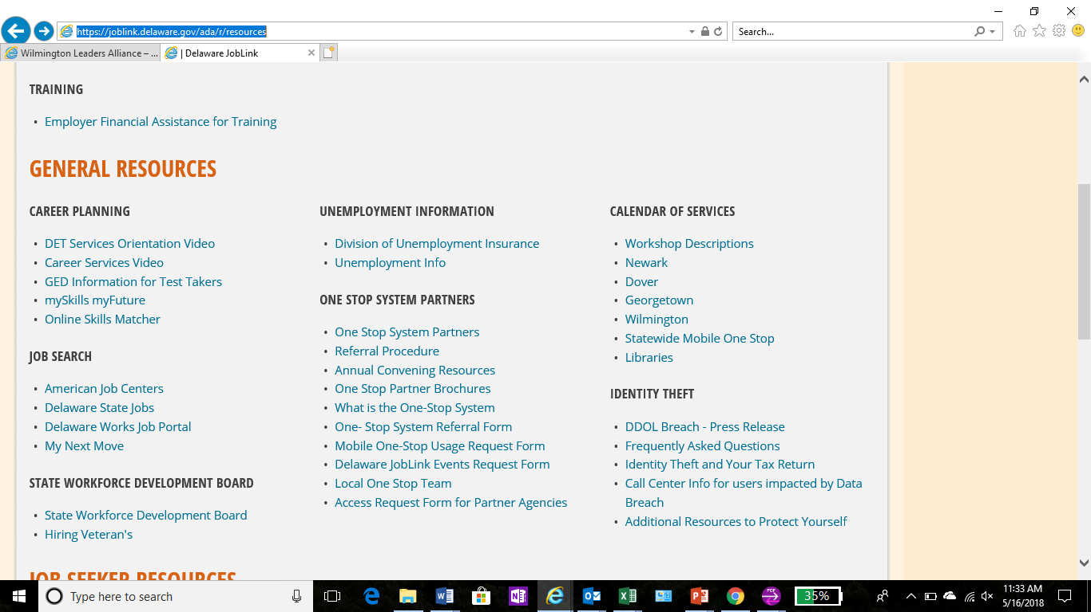

Slide 6
2018 Convening
Upcoming Training Opportunities:
Based on input from One-Stop Team Members, we are planning on-going staff training opportunities in several key areas
More to follow…
Notes:
Good news! We are working on other continuing education opportunities for staff.

Slide 7
Welcome
Welcoming Remarks
Gary Stockbridge
Chair, DE Workforce Dev. Bd.
Chair, DE State Chamber of Commerce Board of Directors
Delmarva Power Region President
Notes:
And now I have the pleasure of introducing Gary Stockbridge…. I’ll start by saying that he is committed to providing job seekers with the specific skills that will help them to succeed. He gives back with him time, so that this can be realized.
Chair, DE Workforce Dev. Bd.; Chair, DE State Chamber of Commerce Board of Directors, Delmarva Power Region President
We have a wonderful partner in Gary who realizes the vital connection between businesses and our workforce development system

